Slide 1
ConnectX Kaggle competition Reinforcement Learning on a two-player game
Max Serra Lasierra
Project for the course “Machine Learning 2” WS22/23
University of Potsdam

Slide 2

Problem setting – Connect4

Slide 3
Why did I change the game?
Too long training times
Comparable enough

Slide 4
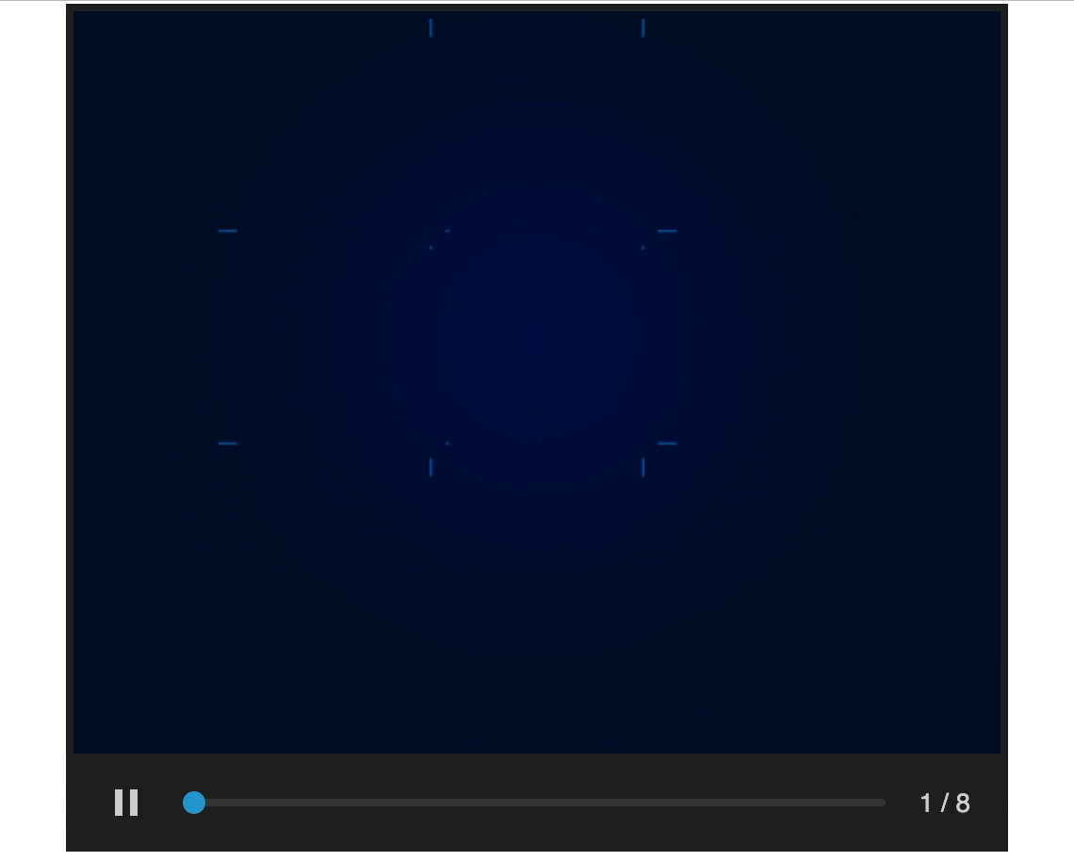
Problem setting – TicTacToe

Slide 5
My approach to the project
Align code to reference libraries:
Gym for environments
Stable Baselines3 for algorithms
Weights and Biases for tracking and evaluating
Select algorithms to use
Define evaluation of agents
Code available on github: https://github.com/maxserra/ml2_project_connectx

Slide 6
My approach to the project – Evaluation
How to evaluate an agent?
Play against another agent
Average cumulative reward
Win rate is a special case with the reward set to 0 – 1
How do we choose the reward function?
Do we program game rules on the agent?
Or, do we let the agent learn them?

Slide 7
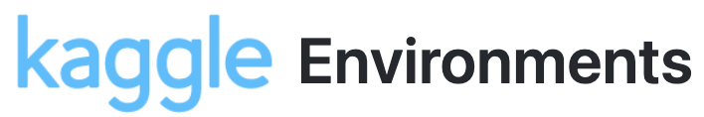

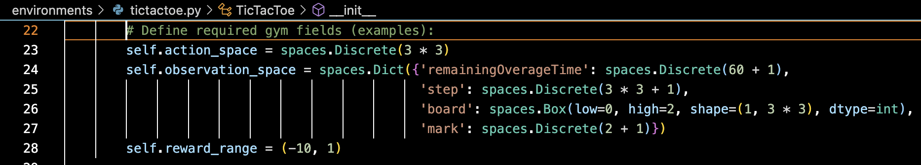
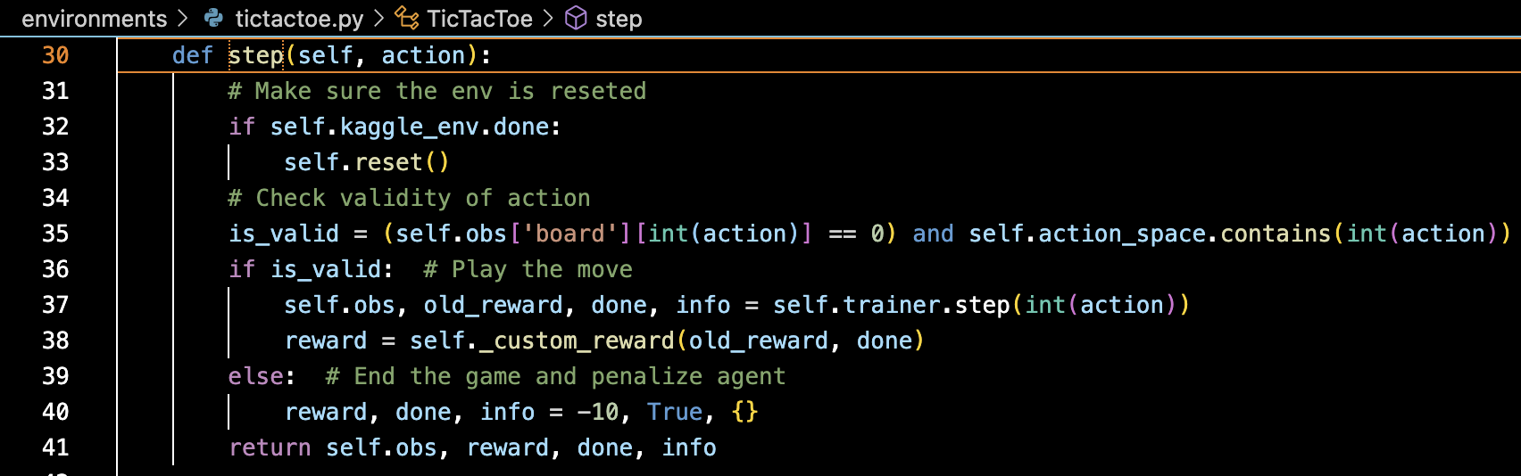
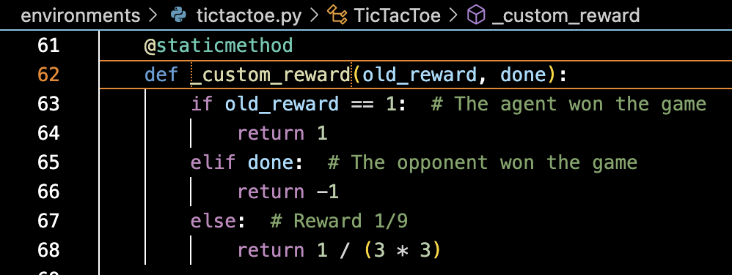
TicTacToe environment
Based on Kaggle environment, adapted to Gym

Slide 8
My approach to the project – Algortihms
Which algorithms could we use?
Temporal-Difference:
Q-Learning
(Expected) Sarsa
Monte Carlo Tree Search

Slide 9
My approach to the project – Algortihms
Which algorithms could we use?
Temporal-Difference:
Q-Learning
(Expected) Sarsa
Monte Carlo Tree Search
Deep Reinforcement Learning (“out-of-the-box” from Stable Baselines3)
DQN
PPO

Slide 10
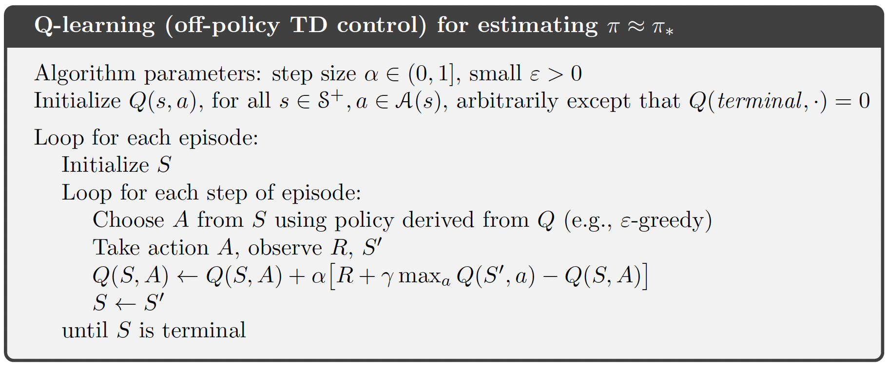
Q-Learning

Slide 11
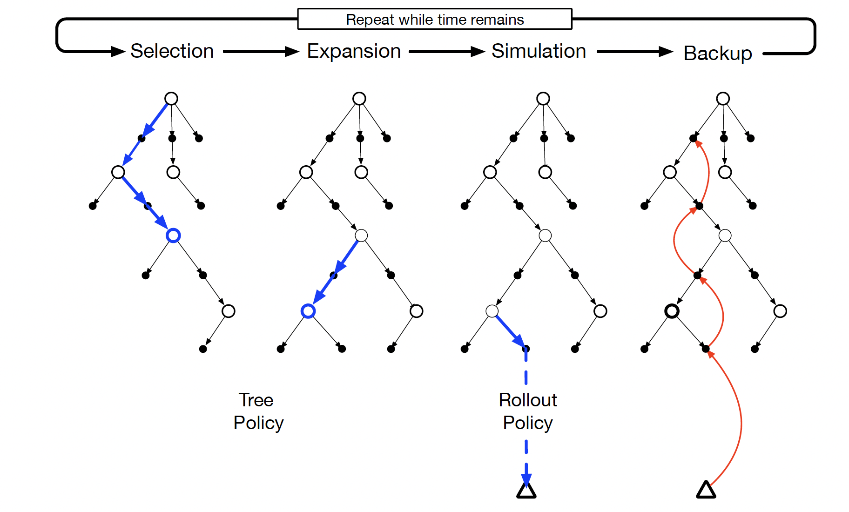
MCTS

Slide 12
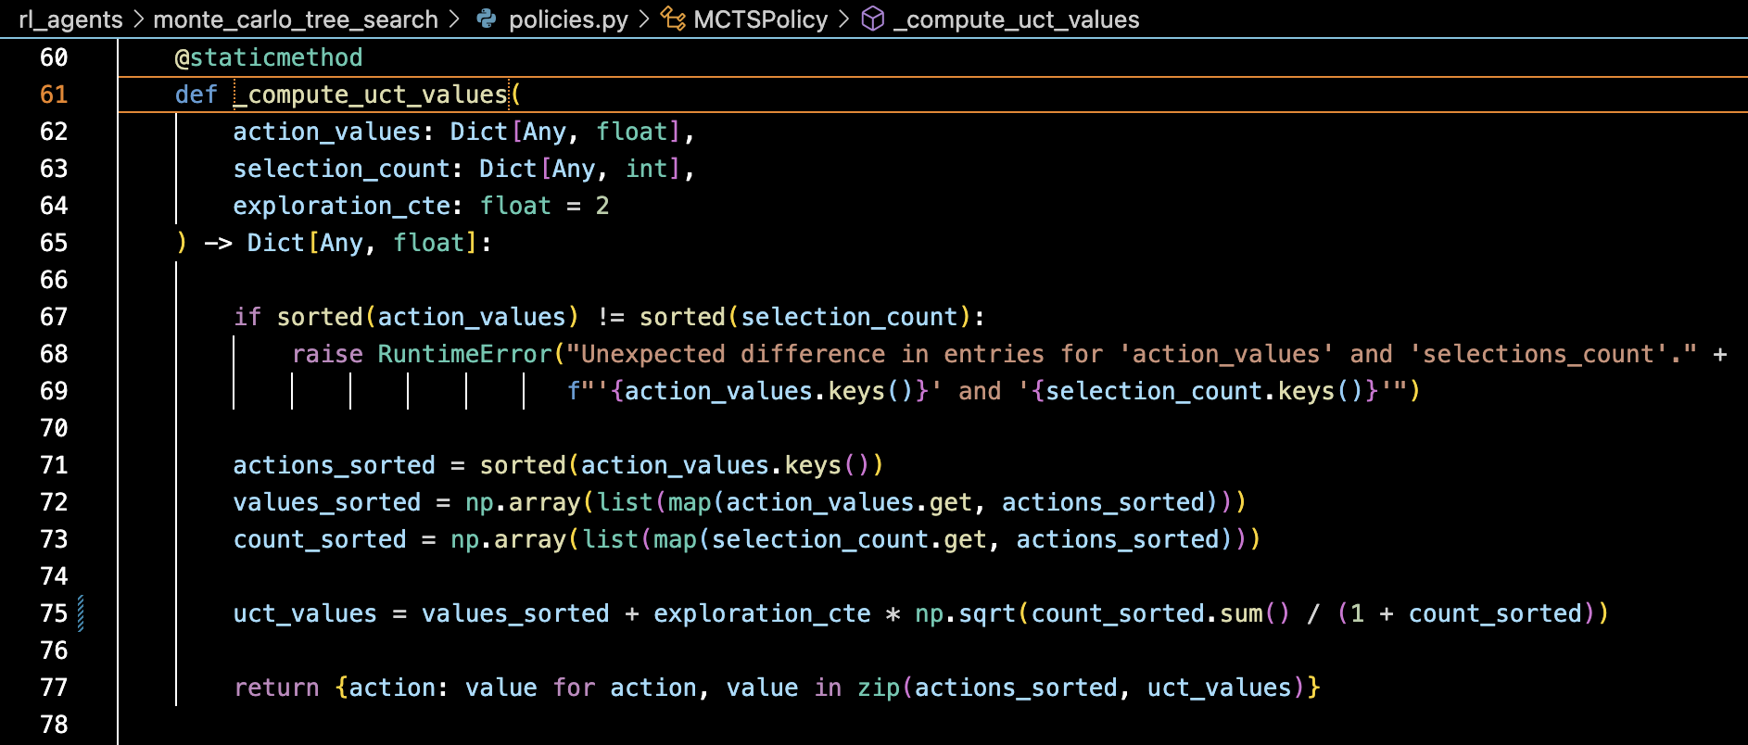
MCTS – Upper Confidence bound for Trees (UCT)

Slide 13
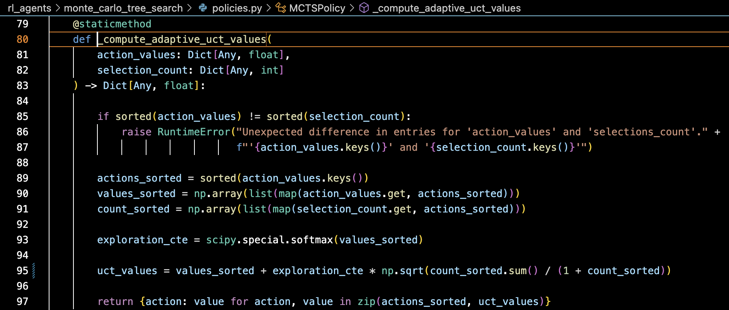
MCTS – Adaptive UCT

Slide 14

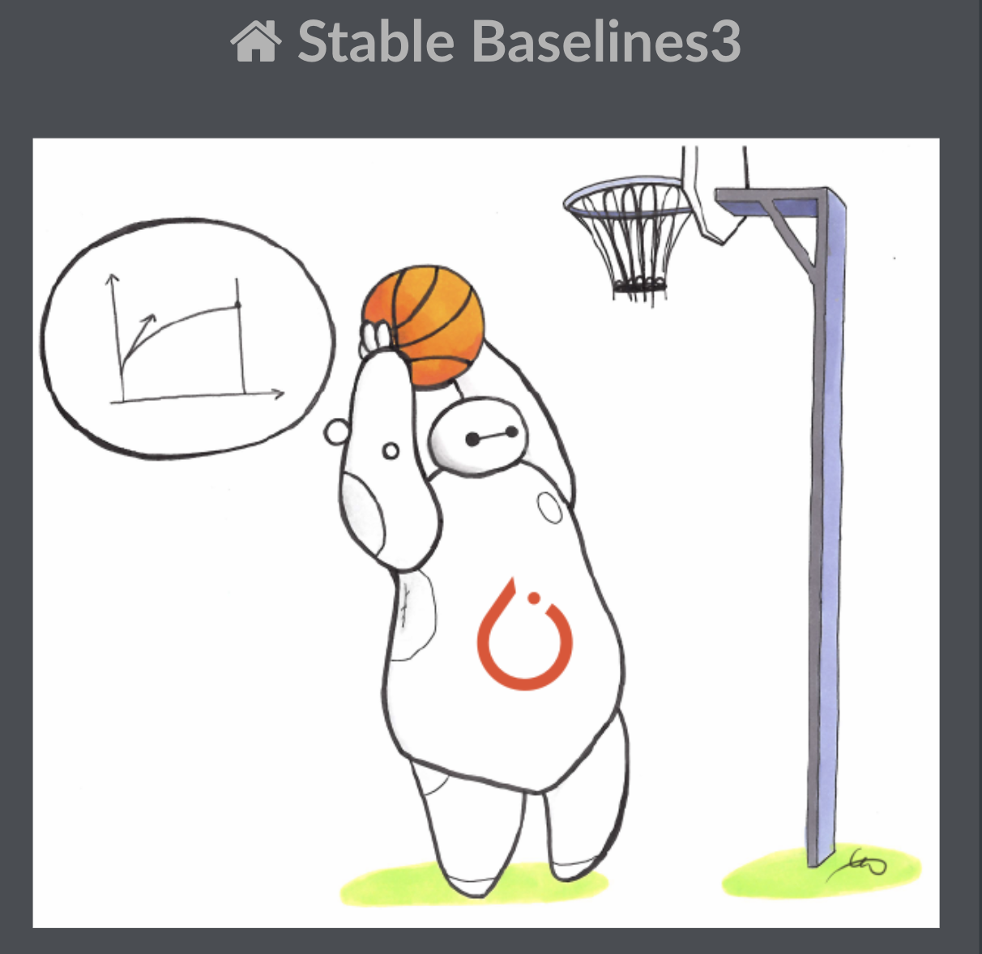
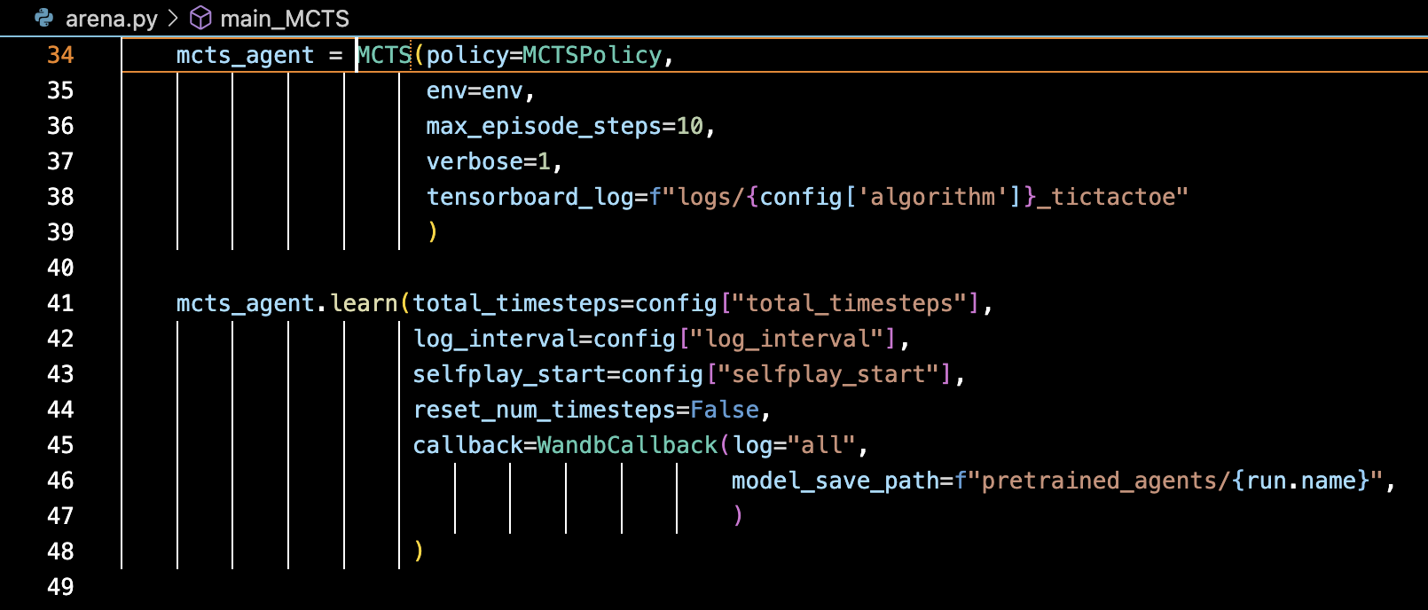
The algorithms I coded
Temporal Difference:
Q-Learning
Sarsa and expected Sarsa
Monte Carlo Tree Search

Slide 15
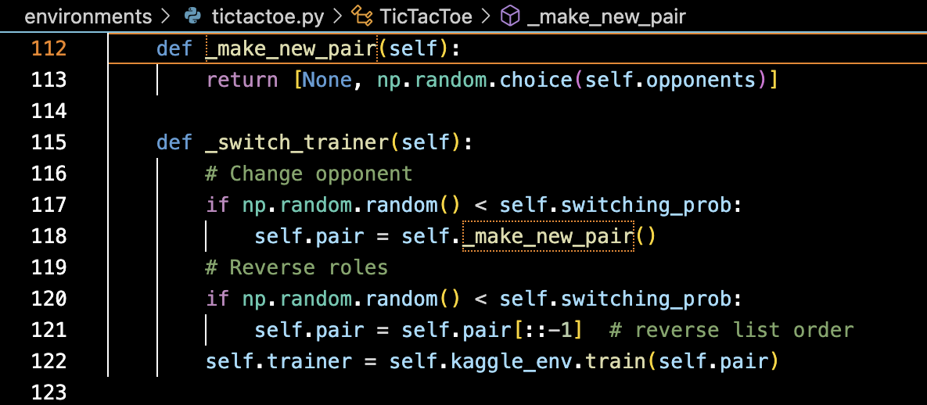
The algorithms I coded
The agent should learn to play both roles!

Slide 16
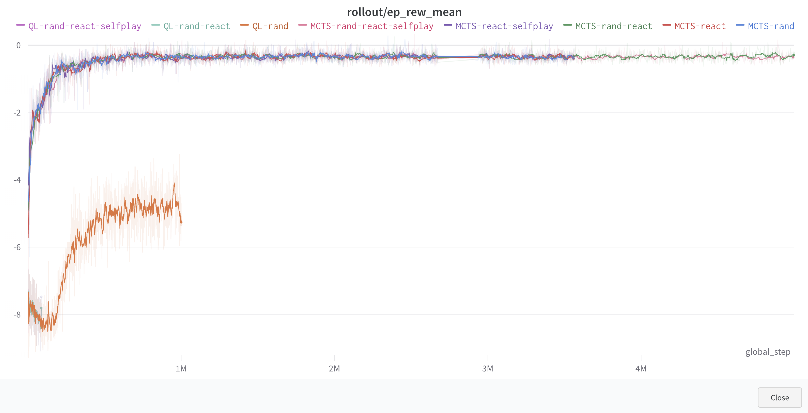
The algorithms I coded – wandb project

Slide 17
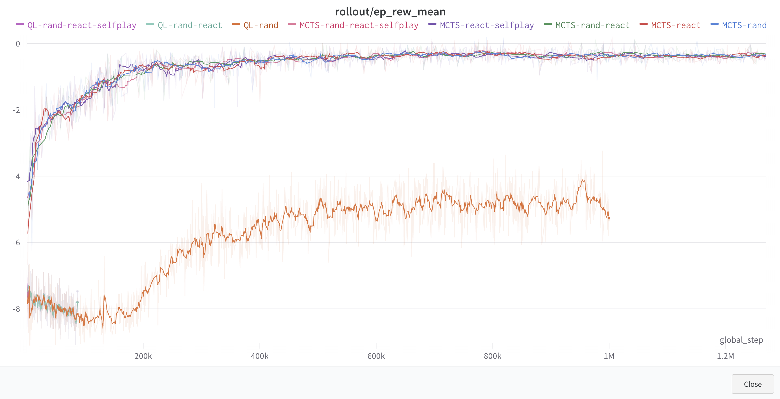
The algorithms I coded – wandb project

Slide 18
The algorithms I did not code
Deep Reinforcement Learning (“out-of-the-box” from Stable Baselines3)
DQN
PPO
The NN is (obviously) exposed and can be modified.

Slide 19
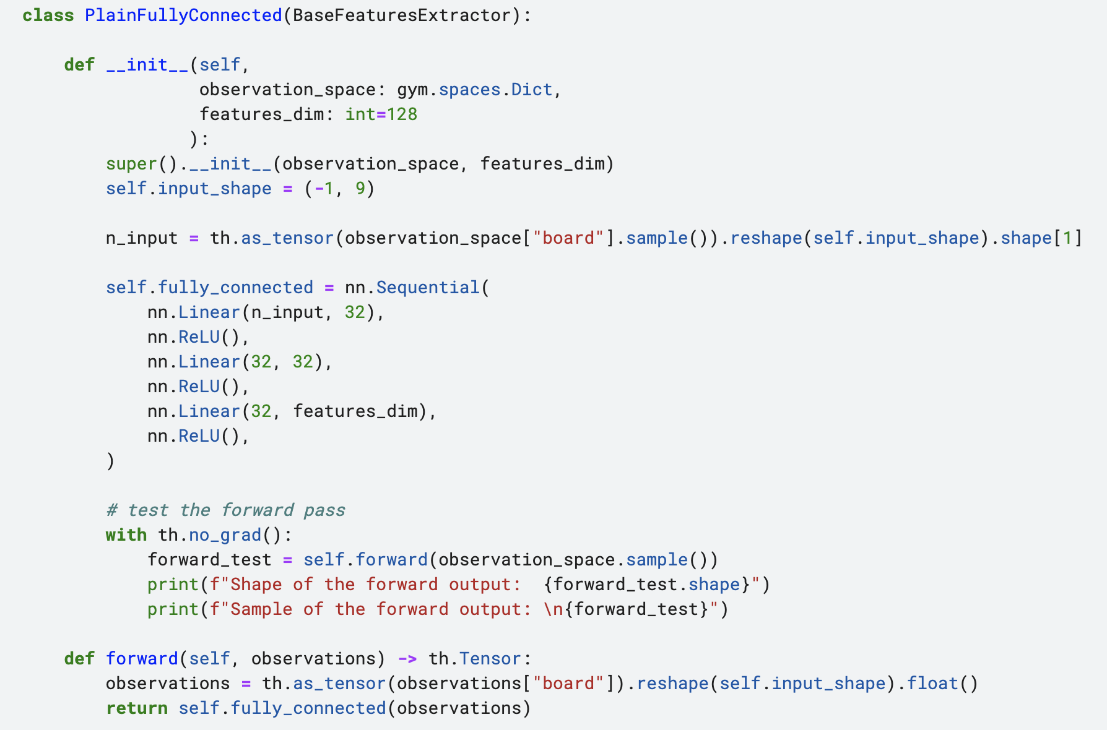
The algorithms I did not code – Kaggle notebook

Slide 20
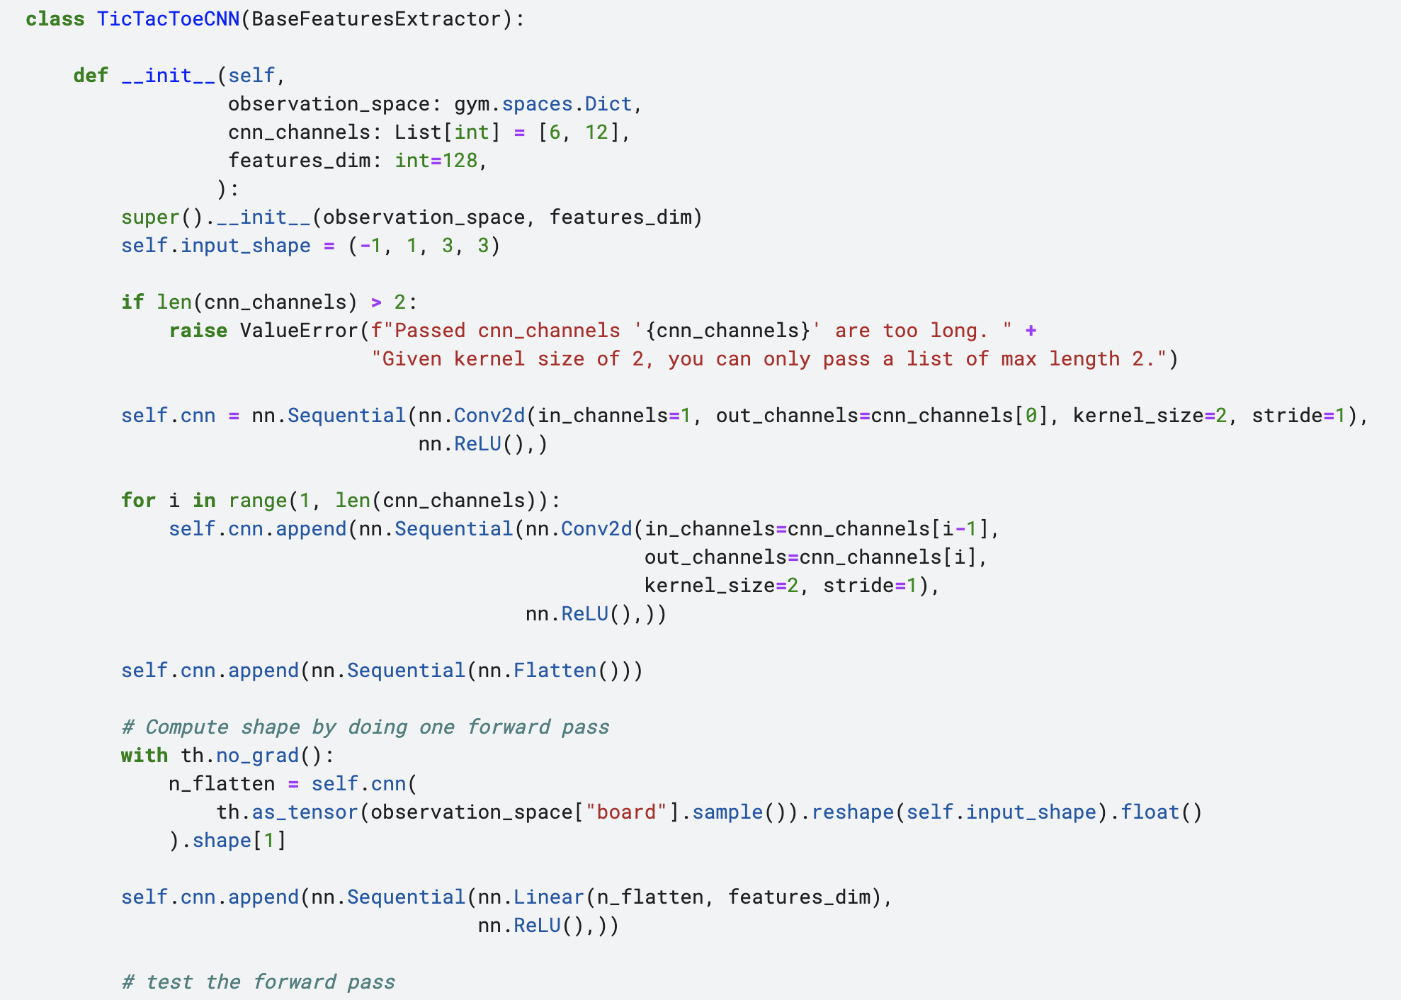
The algorithms I did not code – Kaggle notebook

Slide 21
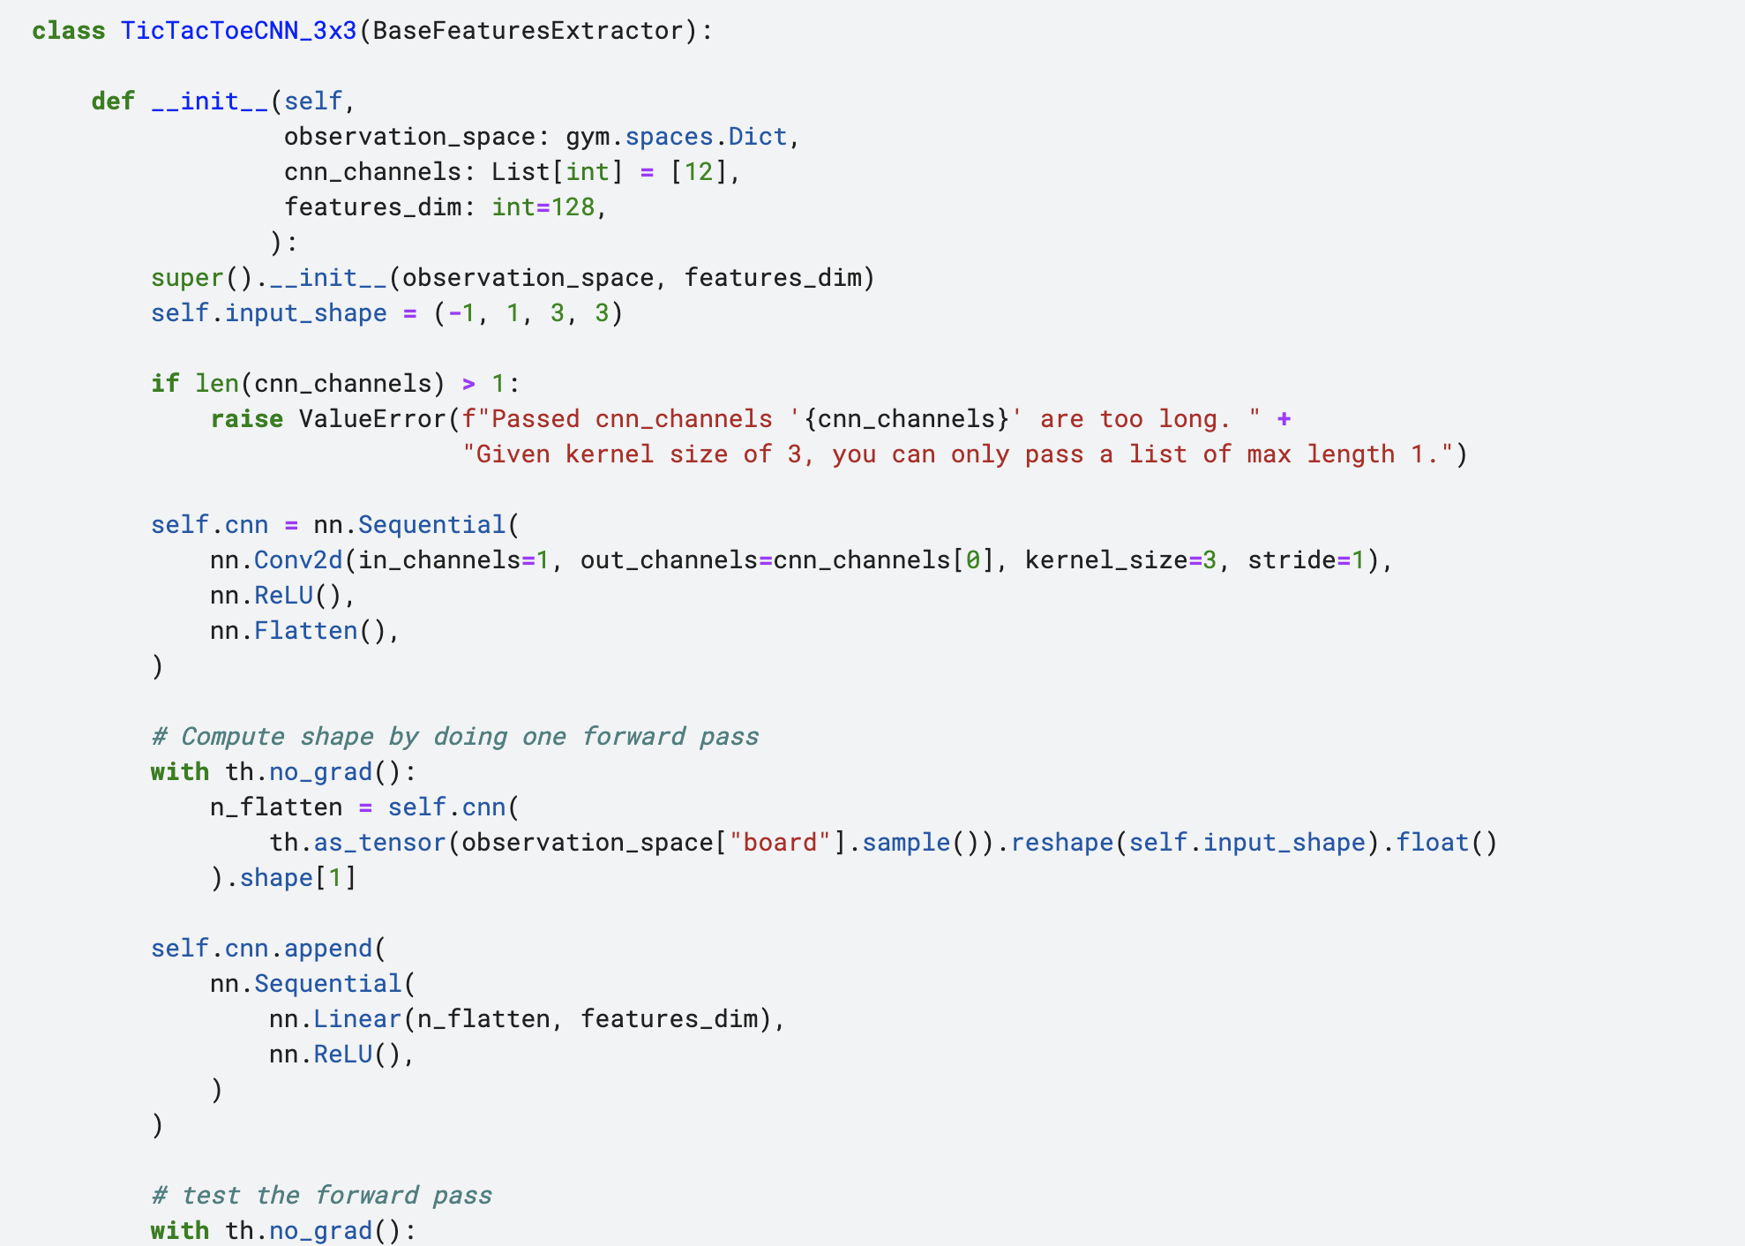
The algorithms I did not code – Kaggle notebook

Slide 22
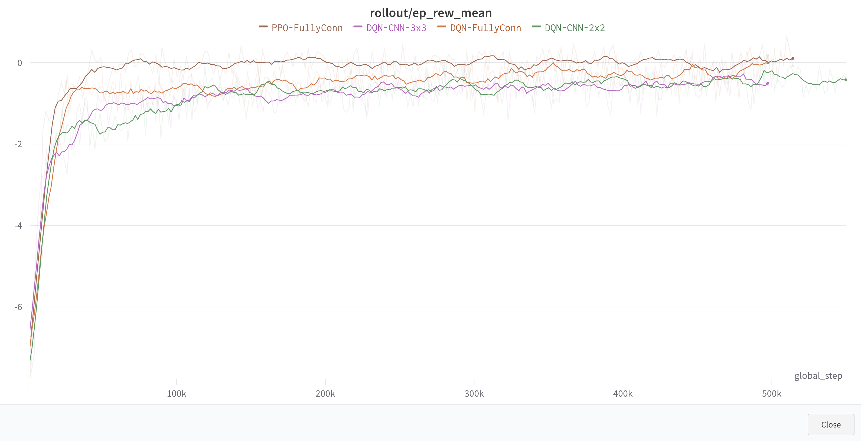
The algorithms I did not code – wandb project

Slide 23
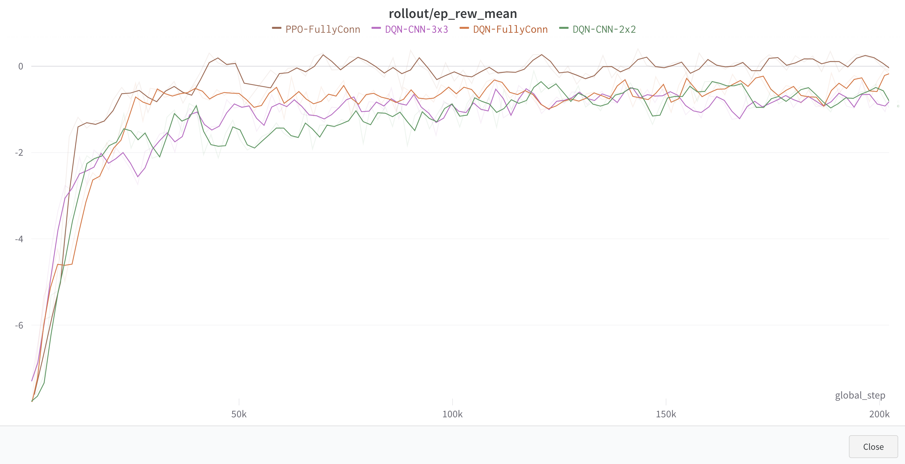
The algorithms I did not code – wandb project

Slide 24
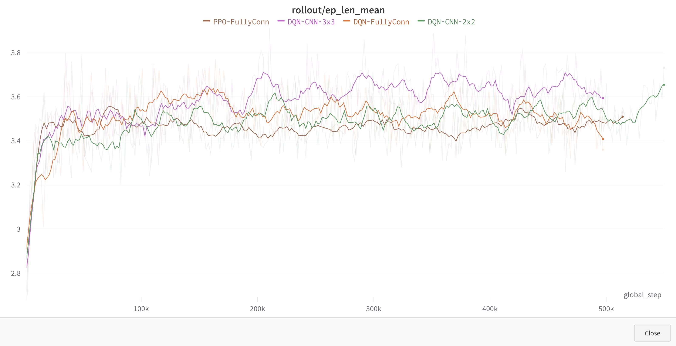
The algorithms I did not code – wandb project

Slide 25
The algorithms I did not code

